Slide 1
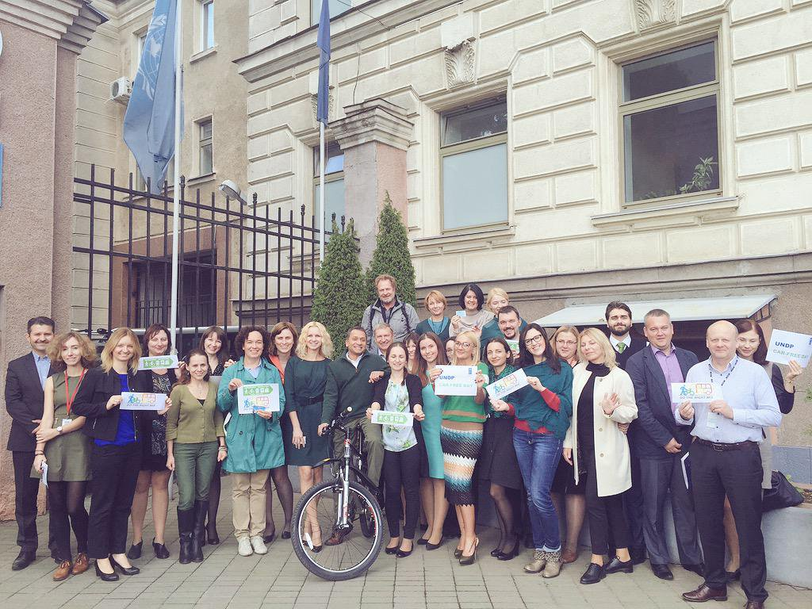



EUROPEANMOBILITYWEEK
16-22 SEPTEMBER
INFORMAL EMW KICK-OFF
Chair: Jerome Simpson with Igar Tchoulba
Senior Expert, Smart Cities and Mobility, REC
27 April 2016, Minsk
#mobilityweek
Smart mobility. Strong economy.
www.mobilityweek.eu

Slide 2


EUROPEANMOBILITYWEEK
16-22 SEPTEMBER
TIME | ACTIVITY
10.00-10.30 | Welcome, Round of Introductions, History of EMW in Belarus incl. introduction of new coordinator
10.30-11.30 | European Mobility Week – Why? What? How? When? Who? Presentation and discussion Why get involved? The three pillars of EMW Registration process MOBILITYACTIONS series Useful resources incl. info on this year’s theme
11.30-11.45 | Coffee break
11.45-12.45 | How can this year’s theme “Smart mobility. Strong economy” be translated into EMW activities? (interactive discussion)
12.45-13.00 | Any other business
Smart mobility. Strong economy.
www.mobilityweek.eu
#mobilityweek #localhashtag

Slide 3
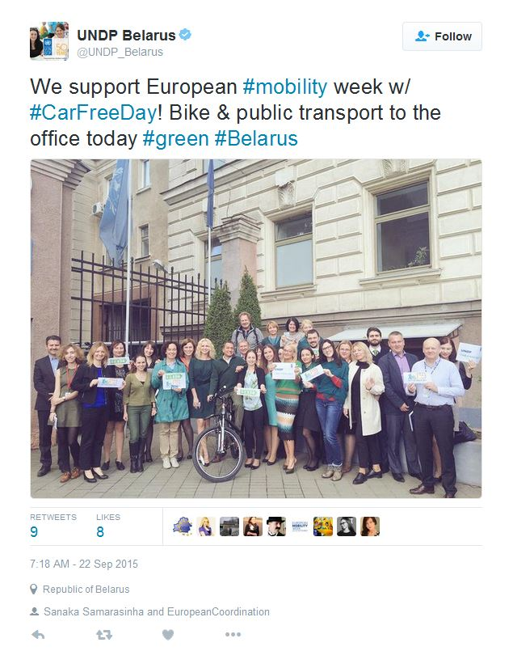
EUROPEANMOBILITYWEEK
16-22 SEPTEMBER
A LITTLE HISTORY
Polotsk signed up through “Interakcia”
Novopolotsk town/city thanks to Dzimitry Babick and the Belarus Transport Union
Minsk with the Center for Environmental Solutions (Pavel Harbunou), the Minsk cycling organization & Green Network
UNDP + new project in two cities
Smart mobility. Strong economy.
www.mobilityweek.eu
#mobilityweek #localhashtag

Slide 4
EUROPEANMOBILITYWEEK
16-22 SEPTEMBER
ORGANISATION | PARTICIPANT NAME
BAMAP (Freight) | TBC
Belarus Transport Union | Dzimitry Babick, Valentina Leonchik (First Deputy Head of the BTU) and Valery Baradzienia, Member of Parliament.
Center for Environmental Solutions | Pavel Harbunou (1000-1100 only) and Artsiom Bystryk
Green Network | Anna Dapsevichyute and Nastassia Bekish
Interakcia | Stanislav Gorelik and Anton Rodnenkov
Minsk bicycle society | Anastasia Yanchevskaya (not yet confirmed) and Kyrill Kudravets (1000-1100 only)
UN Youth Panel in Belarus | Mikita Trafimovich
UNDP/National Coordination | Igar Tchoulba and Natallia Hubskaya (Manager, Green Cities)
EMW European Coordination | Jerome Simpson
Smart mobility. Strong economy.
www.mobilityweek.eu
#mobilityweek #localhashtag

Slide 5

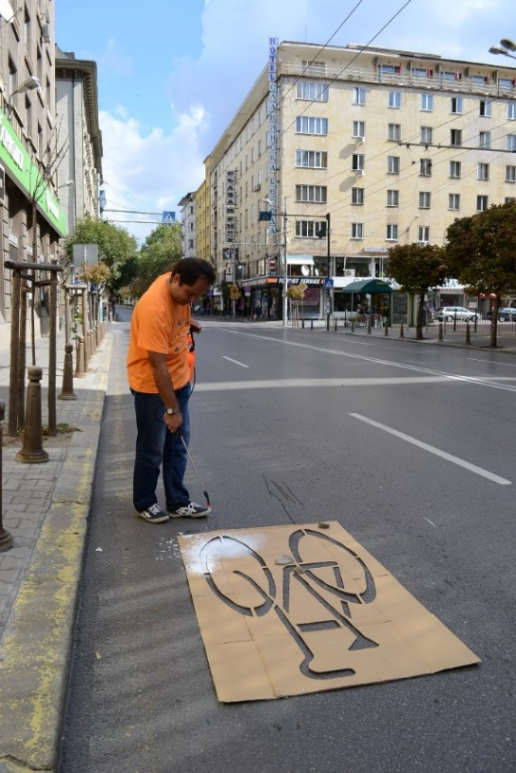
EUROPEANMOBILITYWEEK
16-22 SEPTEMBER
WHY GET INVOLVED?
An opportunity to experiment e.g. with controversial measures such as access or speed restrictions
An occasion to launch permanent measures with the EMW (or MOBILITYACTIONS) label
Solidarity with >2000 cities across Europe in a single Europe-wide campaign, 16-22 Sept.
Even with little or no budget to organise local events and activities, a single permanent measure is enough to register
Opportunity to engage citizens, foster new economic sectors and to catalyse change
Photo credit: City of Sofia
Photo credit: Ostersund
Smart mobility. Strong economy.
www.mobilityweek.eu
#mobilityweek #localhashtag
Notes:
- EMW is a celebration of alternative forms of mobility to the traditional fossil-fueled car.
- The week is also an opportunity to experiment with sustainable urban mobility measures that might not otherwise be implemented.
- It is also the occasion to: inaugurate permanent measures such as bike-paths, pedestrian bridges, reduced speed zones, mobility info points etc.; promote inclusive cities with respect to those whose mobility is limited or insecure e.g. wheelchair users, elderly people, transgendered groups etc.; and to foster safer roads, especially for vulnerable users (children, pedestrians, cyclists, the disabled ...), which brings great PR value for cities and for their mayors
- By participating, cities and citizens become part of a Europe-wide initiative involving over 2000 towns and cities and a quarter of a billion citizens who participate every year from around 45 countries that demonstrate EU solidarity
- Sustainable urban mobility is a powerful tool for boosting growth and employment, creating smart cities, fighting climate change and poor air quality in cities, improving public health and generally increasing our quality of life, especially when combined within the sustainable urban mobility plan (SUMP) framework
- EMW offers an awareness-raising framework to encourage behavioral change among citizens
- The new EMW ‘Mobility Actions’ platform at mobilityweek.eu/mobility-actions/ enables NGO’s, citizen groups, employers etc. to promote sustainable urban mobility actions all year-round, offering both inspirational ideas and a basis for collaboration with municipal administrations.
Your Mayor’s political support can help ensure the success of your city’s campaign
Madeleine: the 'why get involved' bit is the juiciest, where you can really get enthusiastic with info on permanent measure types, and show some nice photos showing typical activities as well as air quality measurement, etc – along with some pictures of permanent pedestrian areas where the campaign can at least partly take credit for the transformation, like Mariahilferstrasse in Vienna, Slovenska street in Ljubljana, and Ribeira Grande in Portugal.

Slide 6






























The campaign is implemented through a network of national coordinators
COUNTRY | MINISTRY
Austria | Environment
Belgium | Environment
Bulgaria | Environment
Croatia | Environment
Cyprus | Environment
Czech Republic | Environment
Denmark | National Ref. Point
Estonia | Environment
Finland | Environment
France | Environment
Germany | Environment
Greece | Environment
Hungary | Transport / Climate
Ireland | Transport
COUNTRY | MINISTRY
Italy | Environment
Latvia | Environment
Lithuania | Environment
Luxembourg | Development and Infrastructure
Malta | Environment
Netherlands | Environment
Poland | Environment
Portugal | Environment
Romania | Environment
Slovakia | Environment
Slovenia | Infrastructure
Spain | Environment
Sweden | Environment
United Kingdom | Environment
Smart mobility. Strong economy.

Slide 7


Every year the European Commission choses a theme
in close consultation with national coordinators
2015 Multimodality Choose. Change. Combine.
2014 Our streets, our choice Quality of life
2013 Clean air, it’s your move! Air quality
2012 Moving in the right direction SUMPs
2011 Alternative Mobility Alternative fuels / clean vehicles
2011 Travel Smarter, Live Better Health
2009 Improving City Climates Climate change
2008 Clean Air for All Air quality
2007 Streets for People Quality of public space
2006 Climate Change Climate change
2005 Clever Commuting Sustainable commuting
2004 Safe Streets for Children Road safety
2003 Accessibility Accessible urban transport
2002 Public Transport, Cycling and Living Streets/Greenways
Smart mobility. Strong economy.

Slide 8
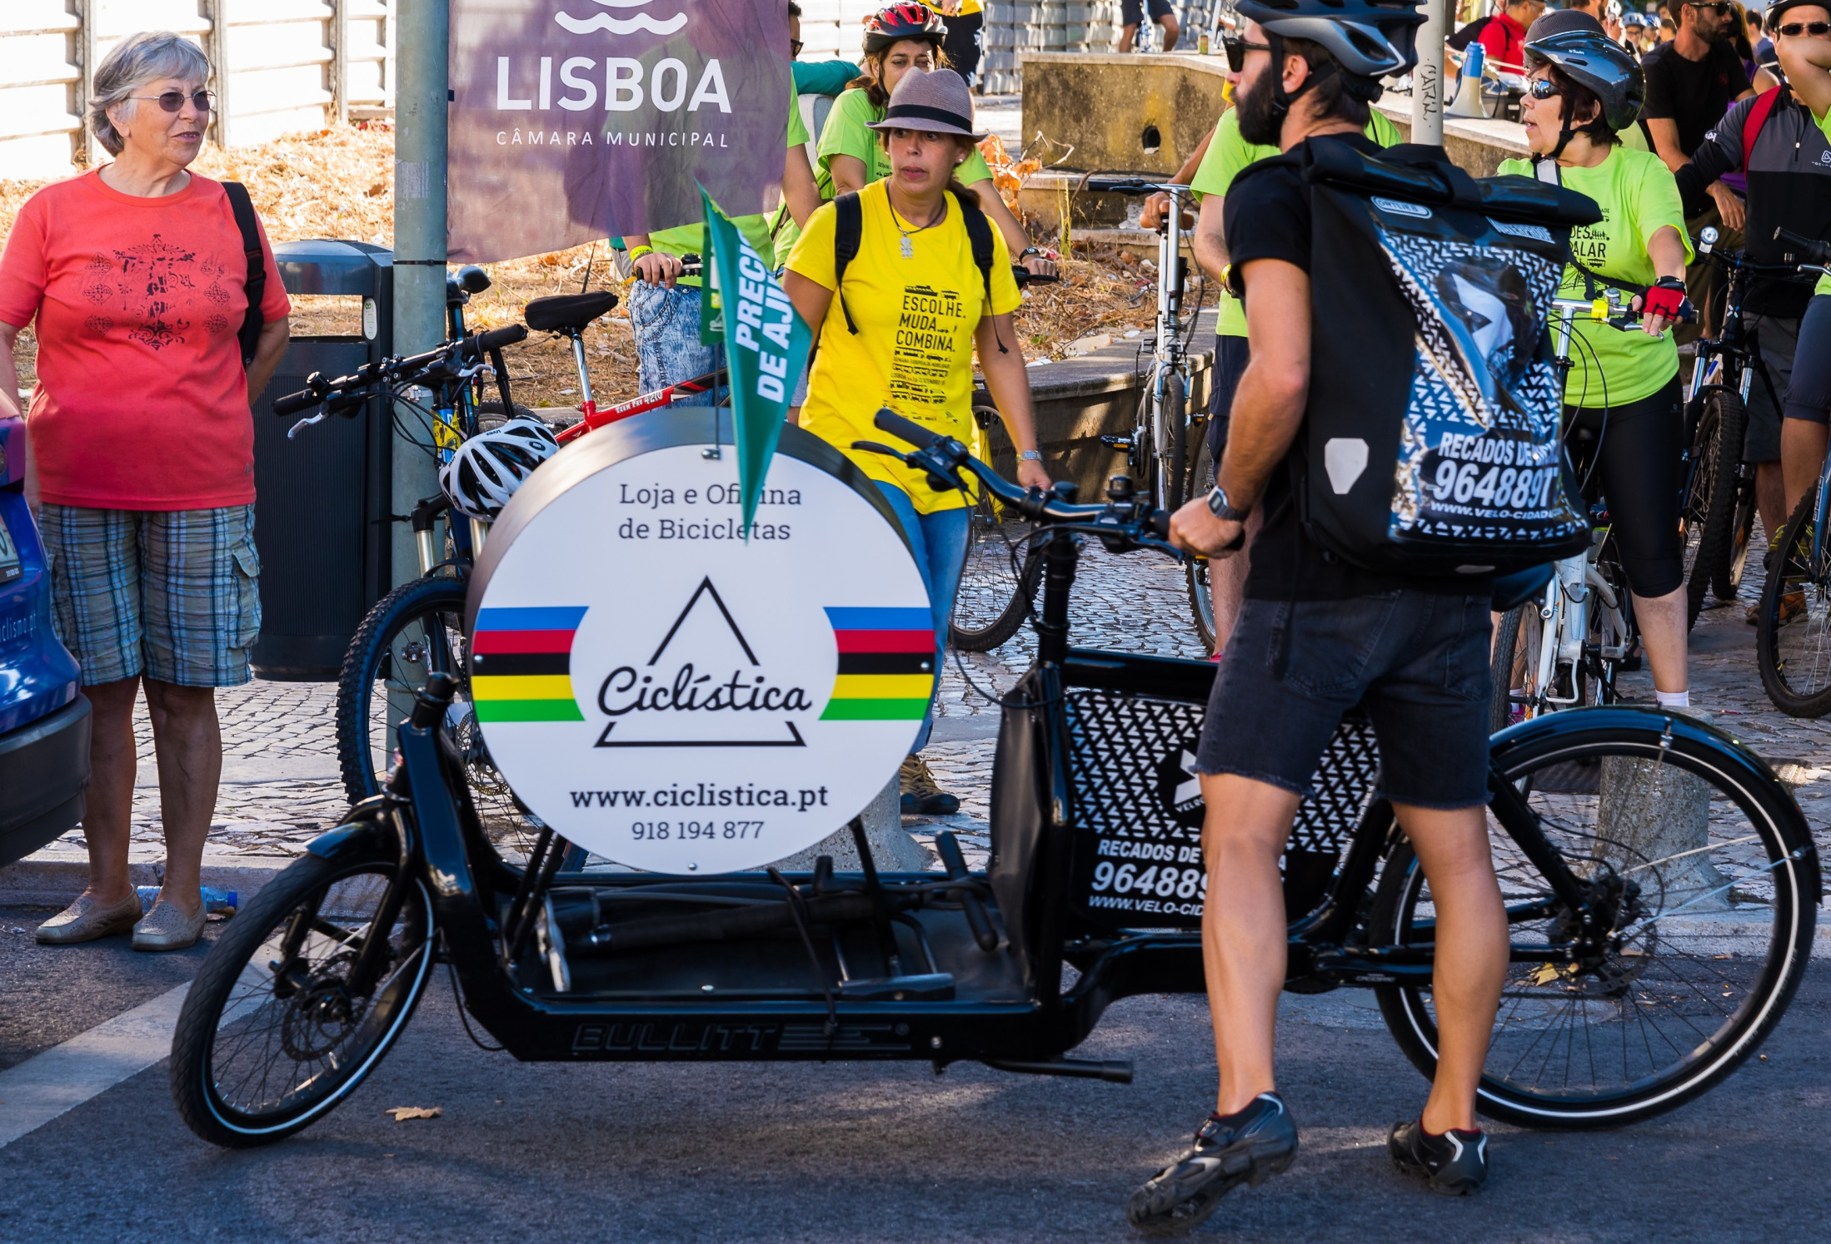


THEME 2016:
‘Smart and sustainable mobility.
An investment for Europe’
With this focal theme we aim at highlighting the economic benefits of smart and sustainable mobility
Smart mobility. Strong economy.
Choose. Change. Combine.
www.mobilityweek.eu
#mobilityweek

Slide 9

1873
cities took part in
EUROPEANMOBILITYWEEK 2015
Smart mobility. Strong economy.
Choose. Change. Combine.
www.mobilityweek.eu
#mobilityweek

Slide 10
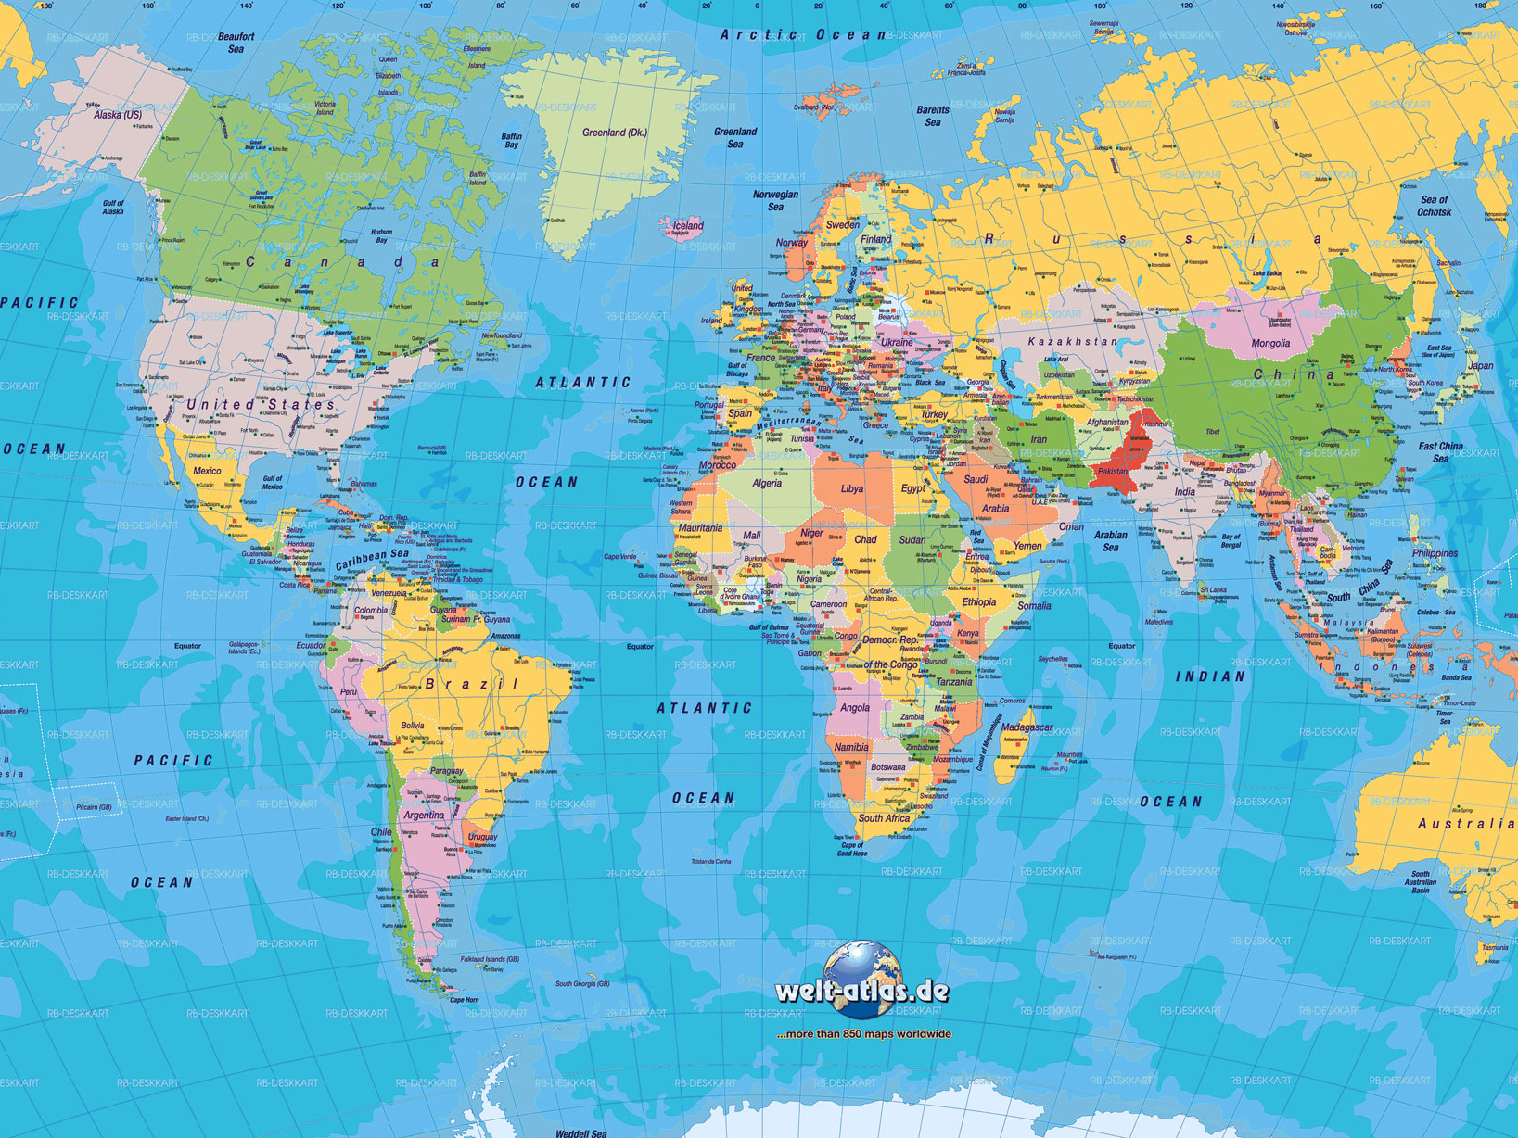
45
countries
indicates a broad geographic spread
Smart mobility. Strong economy.
Choose. Change. Combine.
www.mobilityweek.eu
#mobilityweek

Slide 11




















PARTICIPATION PER COUNTRY - TOP 20
Austria
457
-78
Russia
36
+20
Spain
378
-111
Belgium
35
+5
Hungary
182
+37
Finland
34
+7
Italy
110
-23
Romania
30
-6
Sweden
90
-3
Slovakia
30
+2
Portugal
63
-10
Bulgaria
21
-8
Slovenia
60
+22
Luxembourg
20
-8
Greece
53
+32
Norway
20
+2
France
44
-54
FYR Macedonia
15
+10
Czech Republic
37
+8
Latvia
15
+8
Smart mobility. Strong economy.

Slide 12
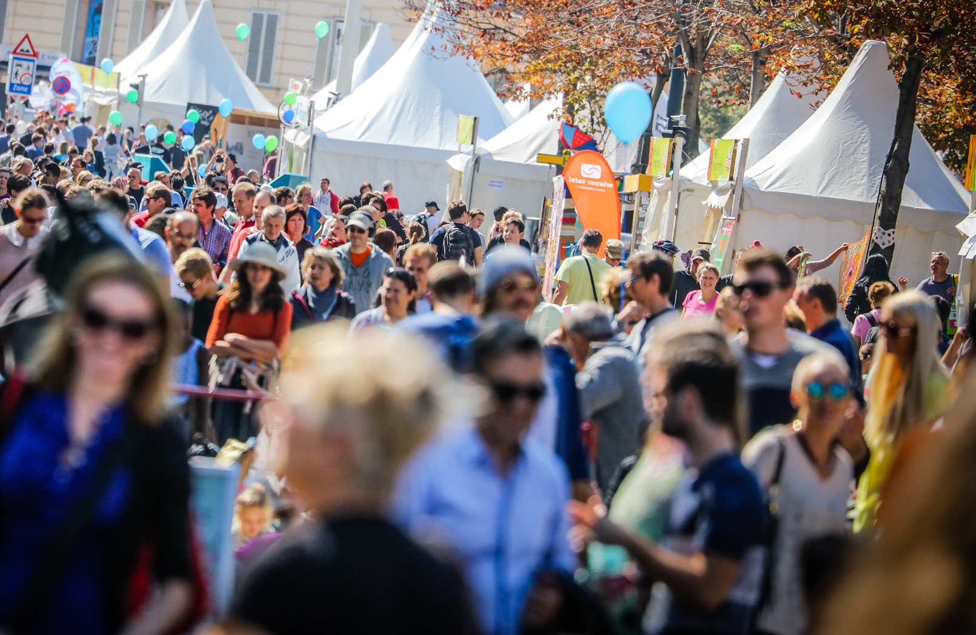
estimated population reach
207,522,488
Smart mobility. Strong economy.
© c.fuerthner/PID
Choose. Change. Combine.
www.mobilityweek.eu
#mobilityweek

Slide 13
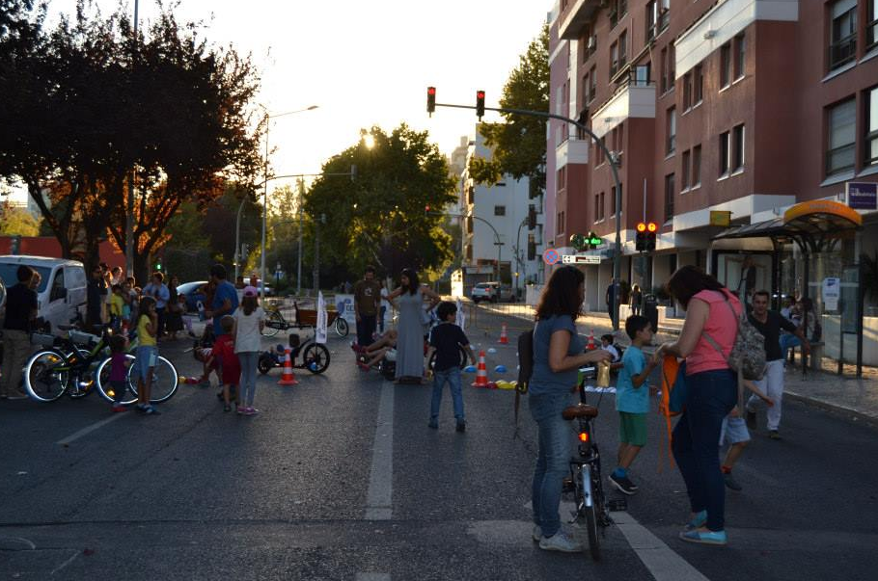
cities organising
Car-Free Day
1742
1477
1488
1452
1394
1310
1262
1281
1254
1114
909
906
854
792
783
730
164
1999 2000 2001 2002 2003 2004 2005 2006 2007 2008 2009 2010 2011 2012 2013 2014 2015
Smart mobility. Strong economy.
Choose. Change. Combine.
www.mobilityweek.eu
#mobilityweek

Slide 14
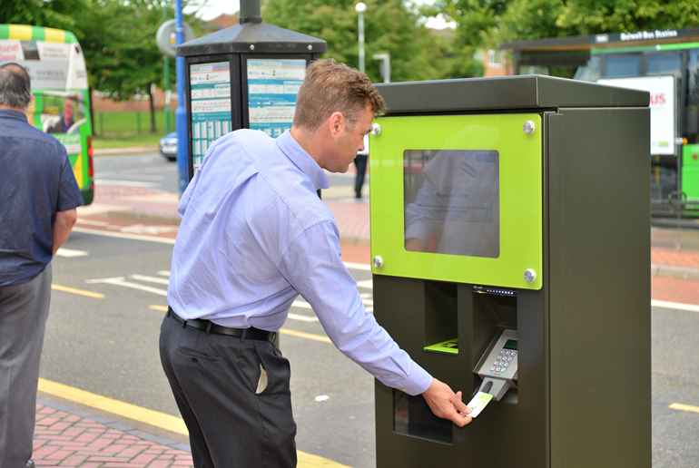
799
5657
3.02
cities declared
they implemented at least
one permanent measure
permanent measures
implemented in 2015
measures implemented
by each city
Smart mobility. Strong economy.
Choose. Change. Combine.
www.mobilityweek.eu
#mobilityweek

Slide 15
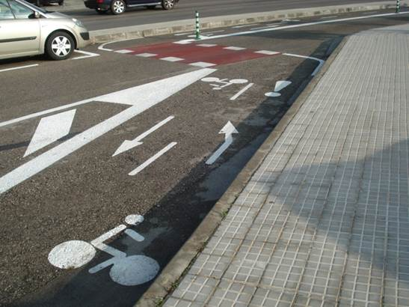
TOP 10 PERMANENT MEASURES IMPLEMENTED IN 2015
Improvement of bicycle network
393
Improvement of infrastructure
369
Improvement of bicycle facilities
326
Launch of awareness-raising campaigns
321
Speed reductions programmes
238
Creation /enlargement of pedestrian areas
233
Lowering of pavements
194
Enlargement of pavements
188
Removal of barriers
164
Education materials
159
Smart mobility. Strong economy.
Choose. Change. Combine.
www.mobilityweek.eu
#mobilityweek

Slide 16

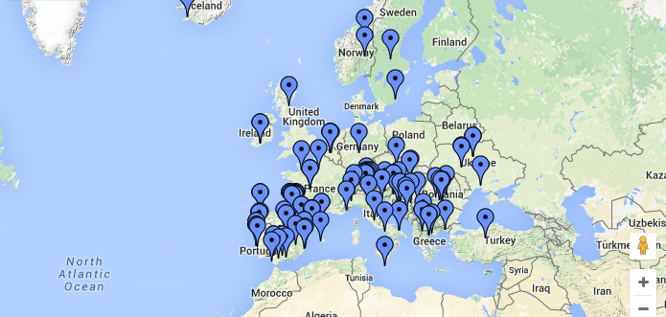
Heritage from
NEW feature!
177
registered
MOBILITYACTIONS
22
countries
Smart mobility. Strong economy.
Choose. Change. Combine.
www.mobilityweek.eu
#mobilityweek

Slide 17
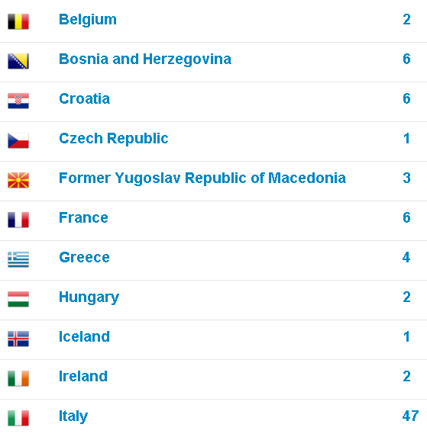
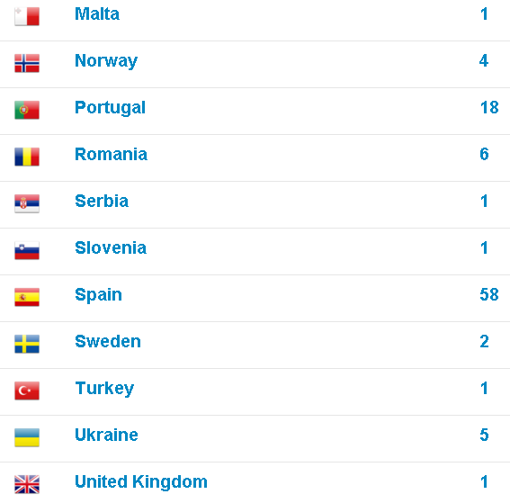
Smart mobility. Strong economy.
Choose. Change. Combine.
www.mobilityweek.eu
#mobilityweek

Slide 18
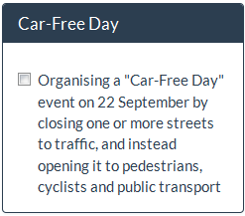
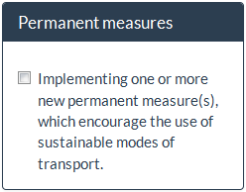
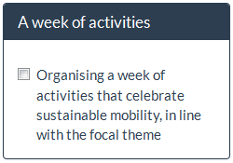
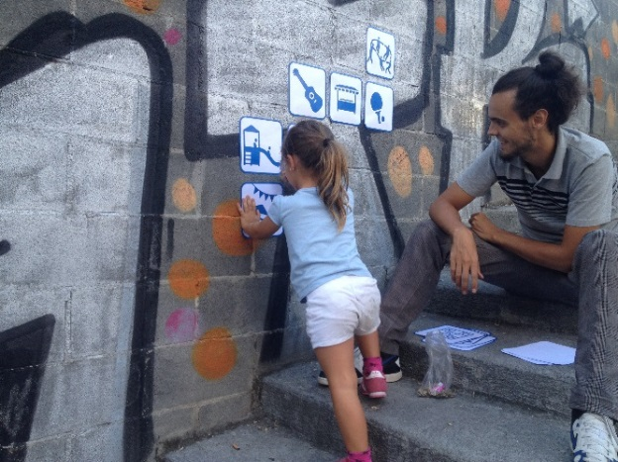
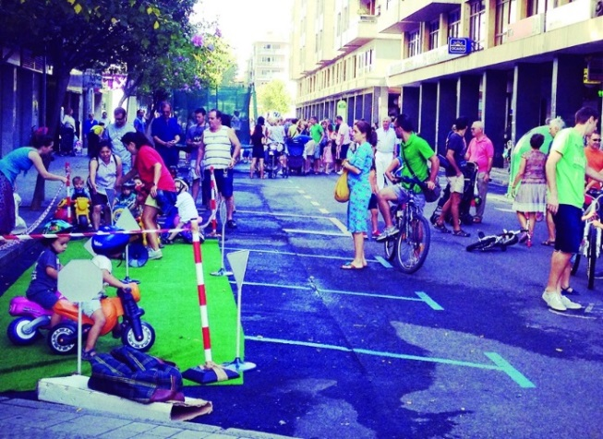
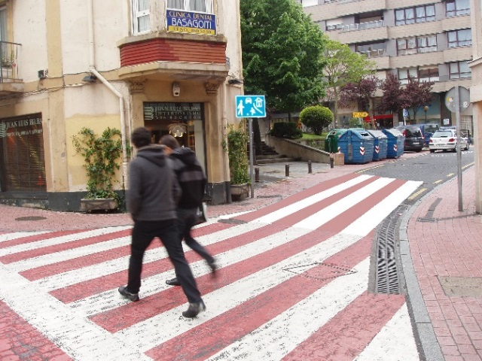
EUROPEANMOBILITYWEEK
16-22 SEPTEMBER
3 PILLARS
Photo credit: Josu Ateca Acebo
Photo credit: Josu Ateca Acebo
Photo credit: Josu Ateca Acebo
Smart mobility. Strong economy.
www.mobilityweek.eu
#mobilityweek #localhashtag

Slide 19


The campaign provides an opportunity
for local authorities
to test out pedestrian zones…
Smart mobility. Strong economy.

Slide 20
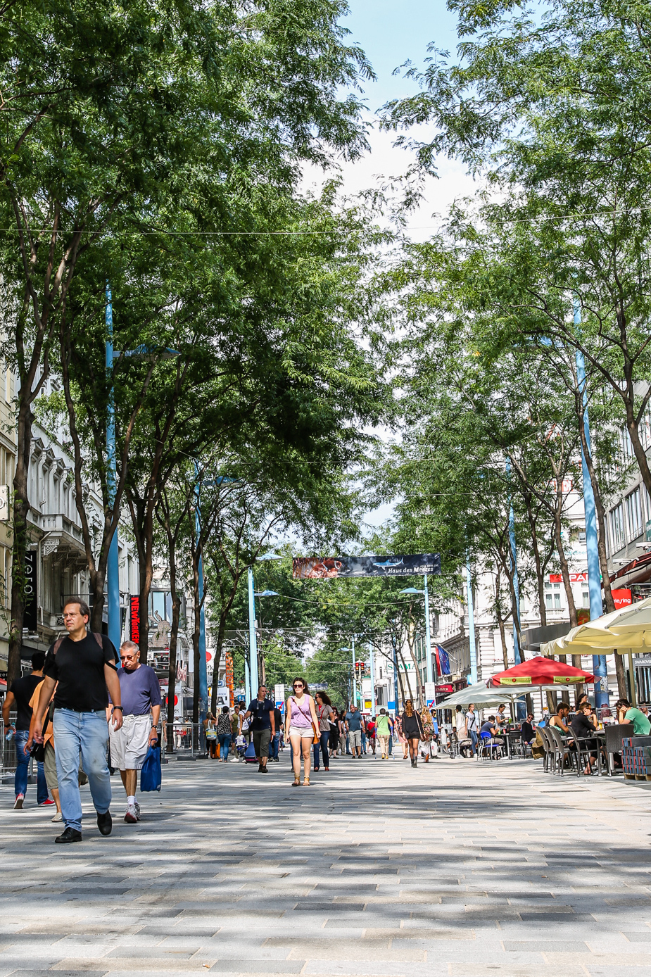
© c.fürthner/MA28
…many of which become permanent
Vienna
Mariahilfer straße
Smart mobility. Strong economy.
Choose. Change. Combine.
www.mobilityweek.eu
#mobilityweek

Slide 21
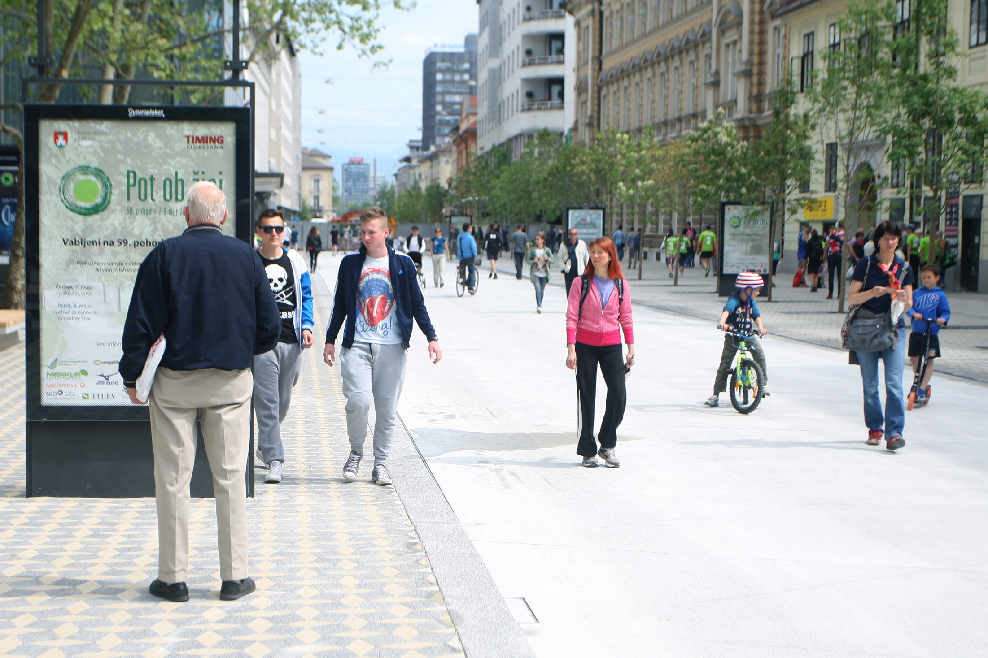
© Nik Rovan
Ljubljana
Slovenska Street
Smart mobility. Strong economy.
Choose. Change. Combine.
www.mobilityweek.eu
#mobilityweek

Slide 22
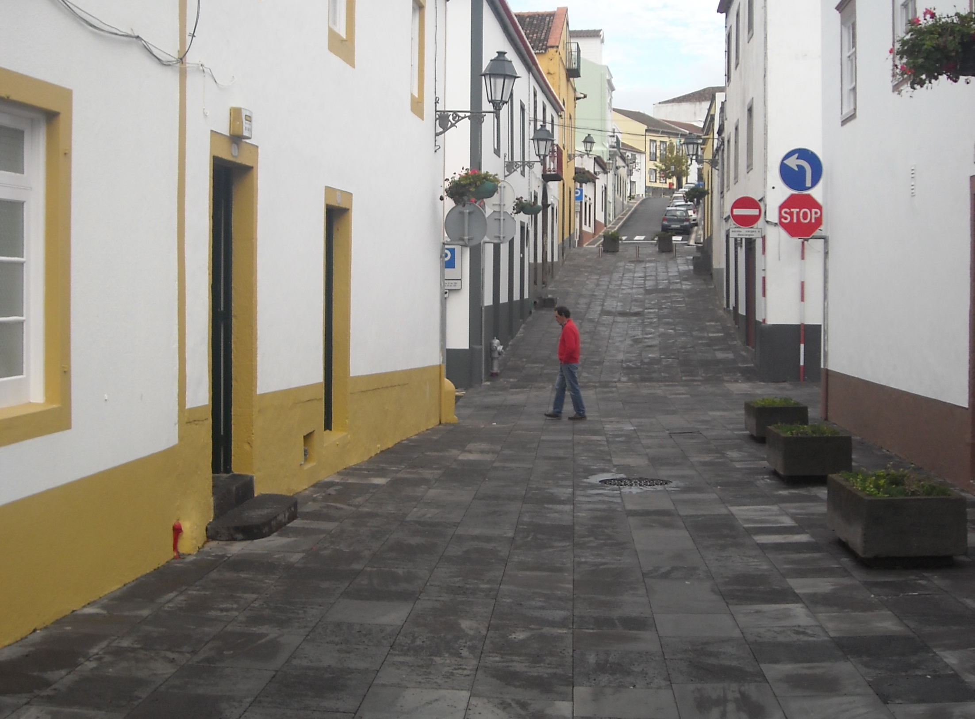
Ribeira Grande
Portugal
Smart mobility. Strong economy.
Choose. Change. Combine.
www.mobilityweek.eu
#mobilityweek

Slide 23

During the week cities and towns
raise awareness on issues such as:



Air quality
Environment
Road safety
Smart mobility. Strong economy.

Slide 24
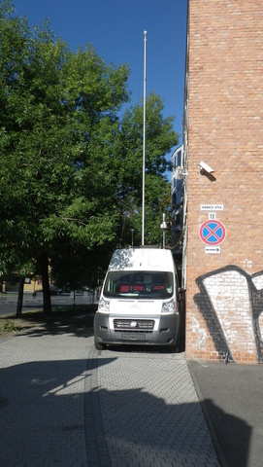
Air quality measurements in
Miskolc
Hungary
Smart mobility. Strong economy.
Choose. Change. Combine.
www.mobilityweek.eu
#mobilityweek

Slide 25
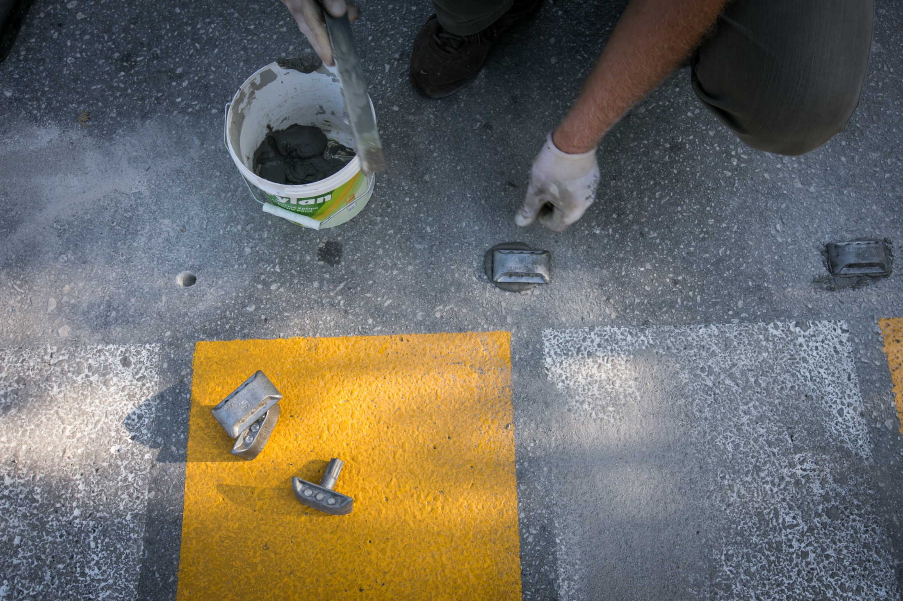
© www.floulis.gr
Placement of road reflectors in
Trikala
Greece
Smart mobility. Strong economy.
Choose. Change. Combine.
www.mobilityweek.eu
#mobilityweek

Slide 26
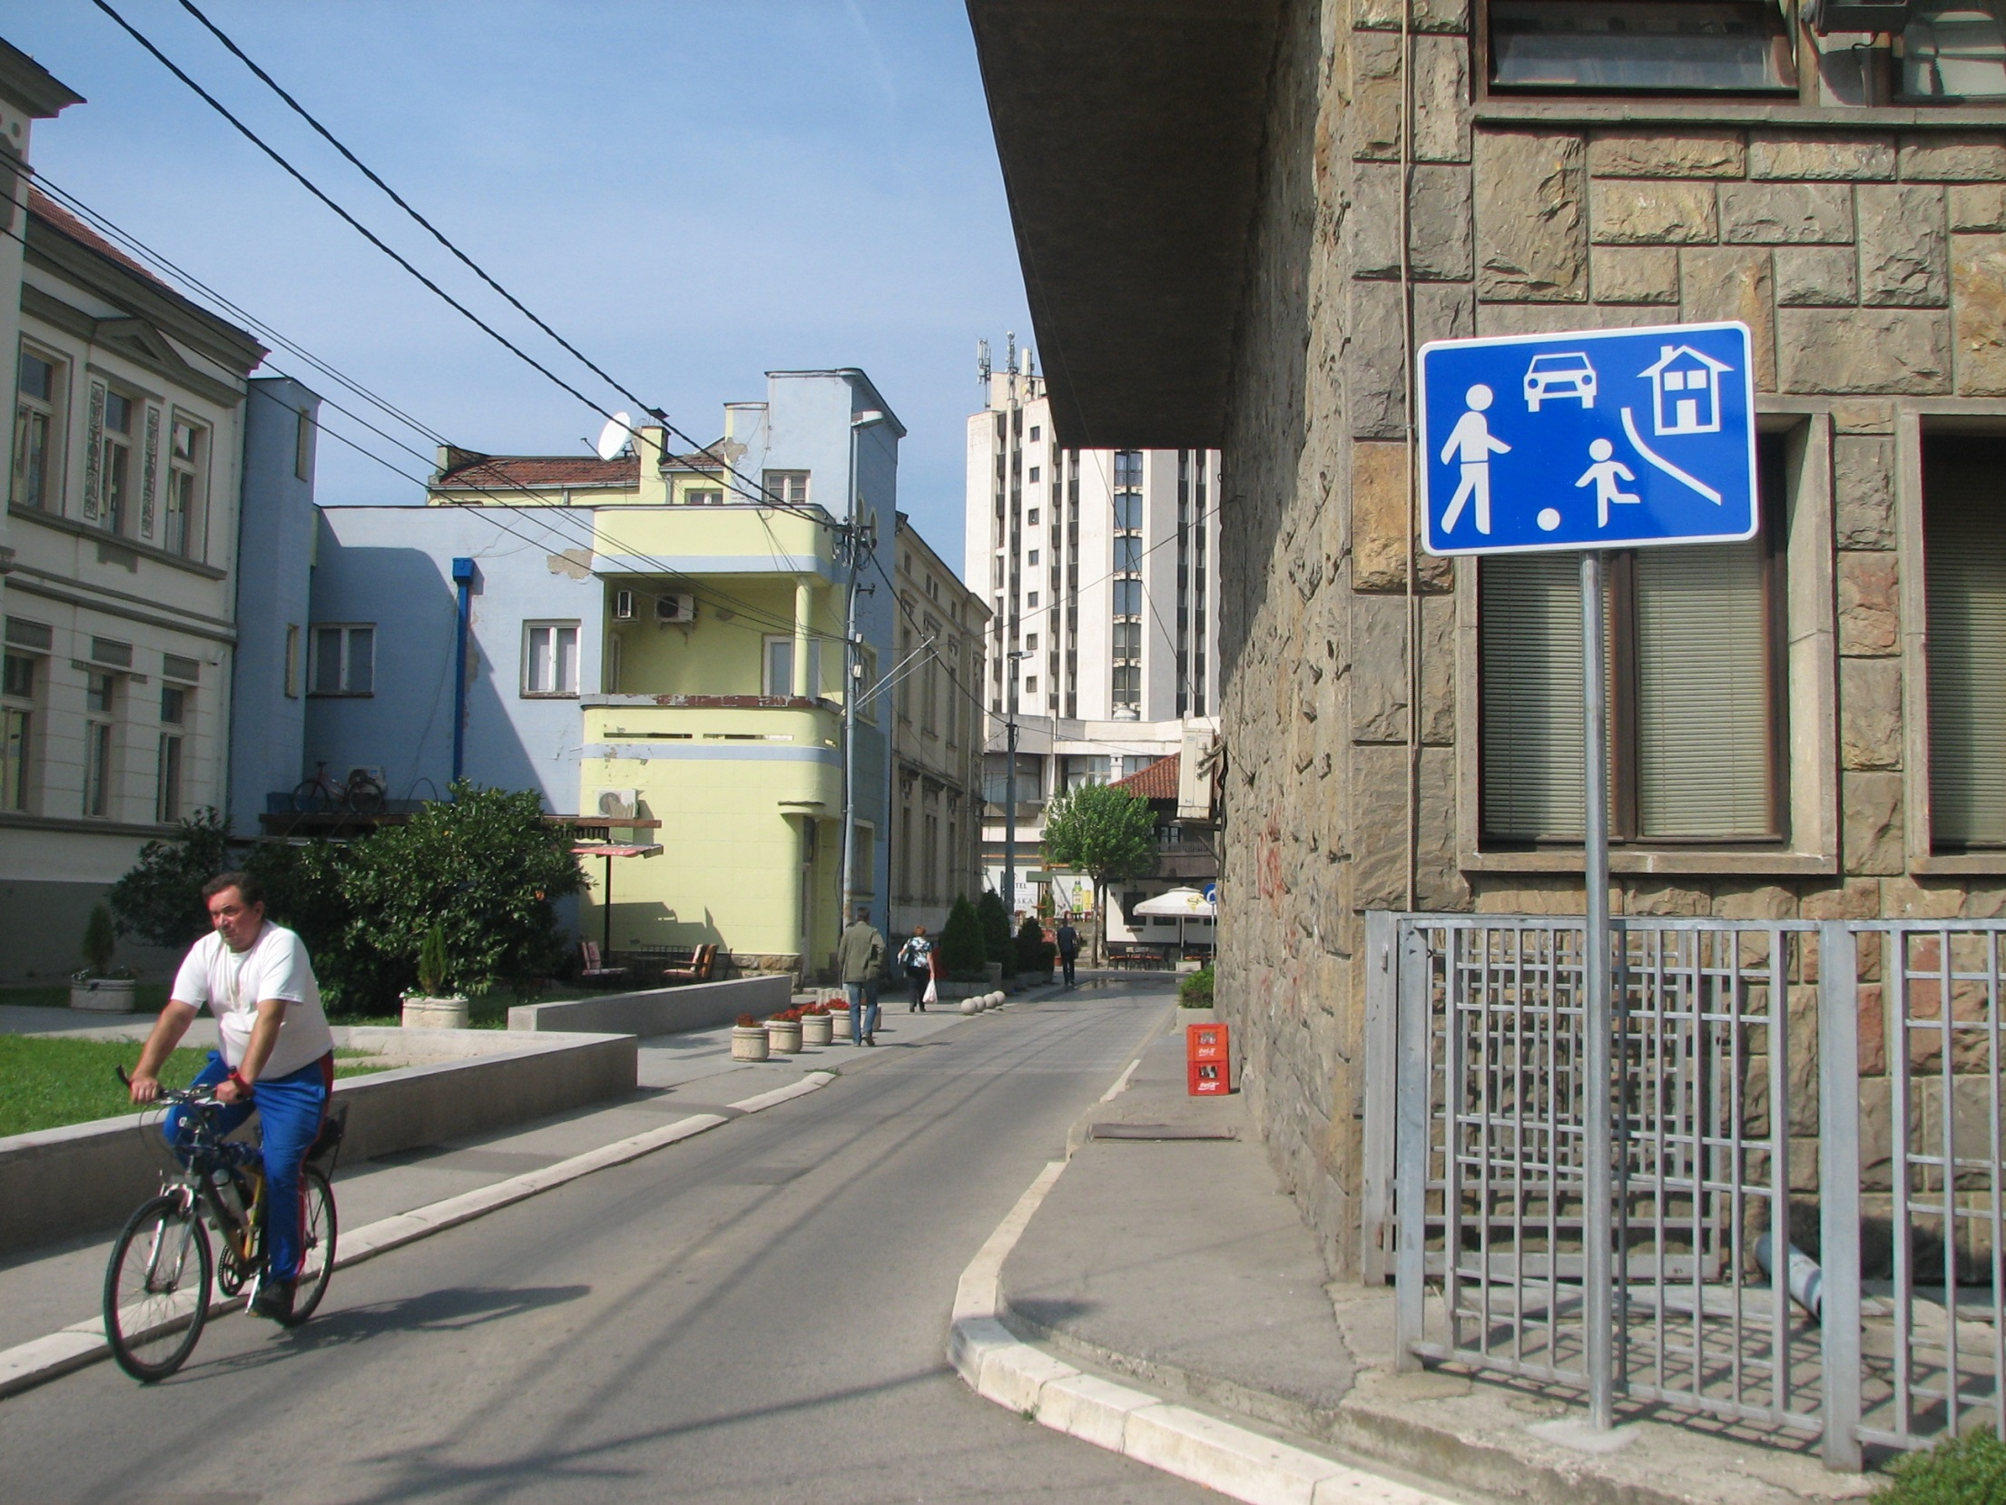
Introduction of speed limit zones in
Krusevac
Serbia
Smart mobility. Strong economy.
Choose. Change. Combine.
www.mobilityweek.eu
#mobilityweek

Slide 27

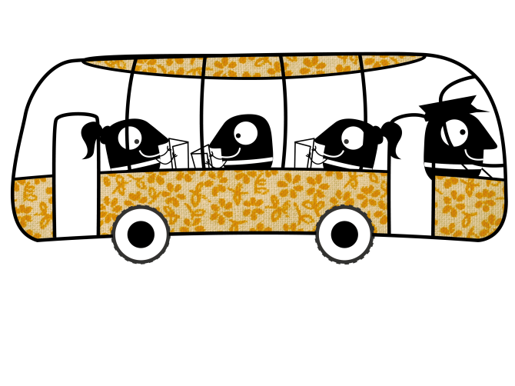
A wide variety of initiatives
makes the campaign popular and successful
festival in train station
public transport
free bike rental
free insurance for cyclists
car-free holiday offers
active commuting
commuter races
teleworking promotion
car-sharing offers
redesign of parking spaces
decorate the streets
Smart mobility. Strong economy.

Slide 28
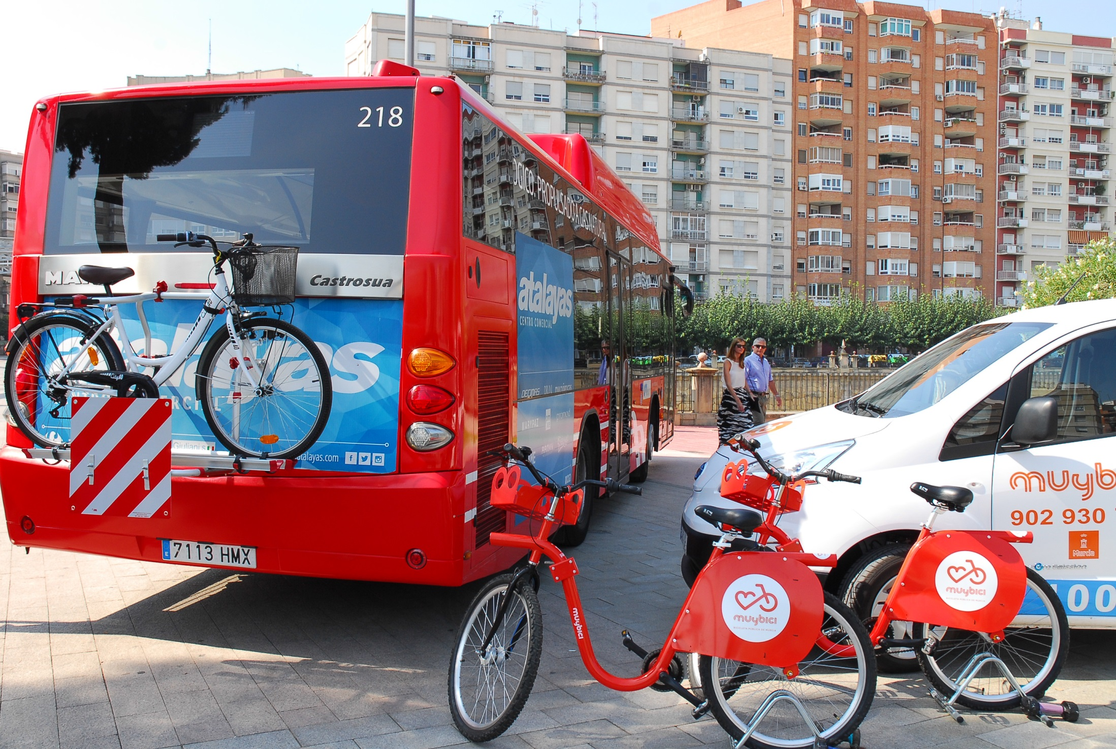
Multimodality in public transport
Murcia
Spain
Smart mobility. Strong economy.
Choose. Change. Combine.
www.mobilityweek.eu
#mobilityweek

Slide 29
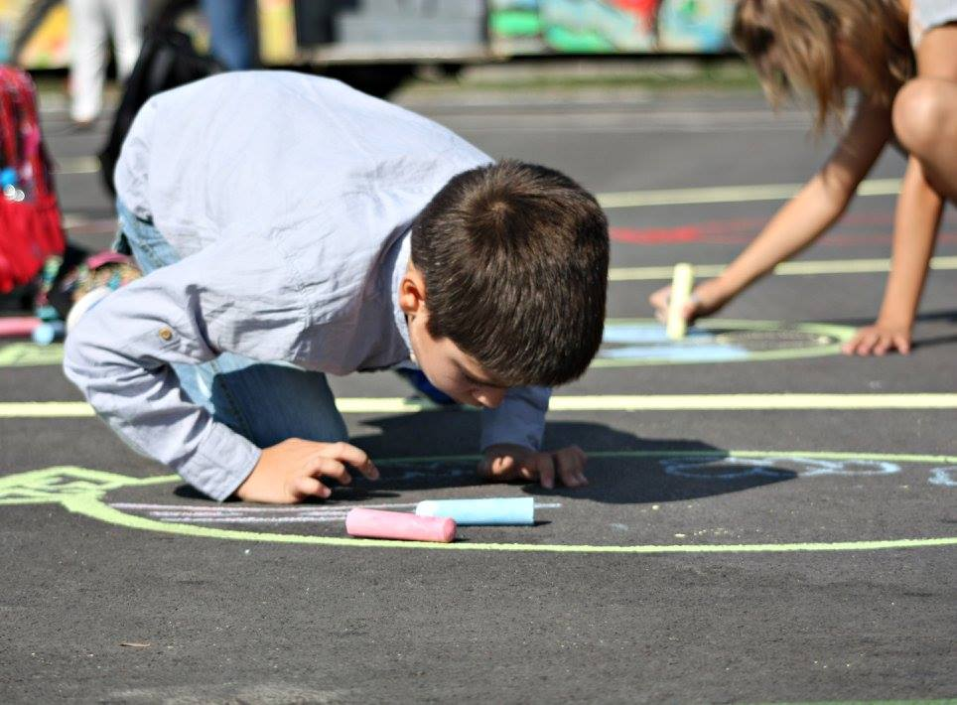
Decorating the streets
Sofia
Bulgaria
Smart mobility. Strong economy.
Choose. Change. Combine.
www.mobilityweek.eu
#mobilityweek

Slide 30
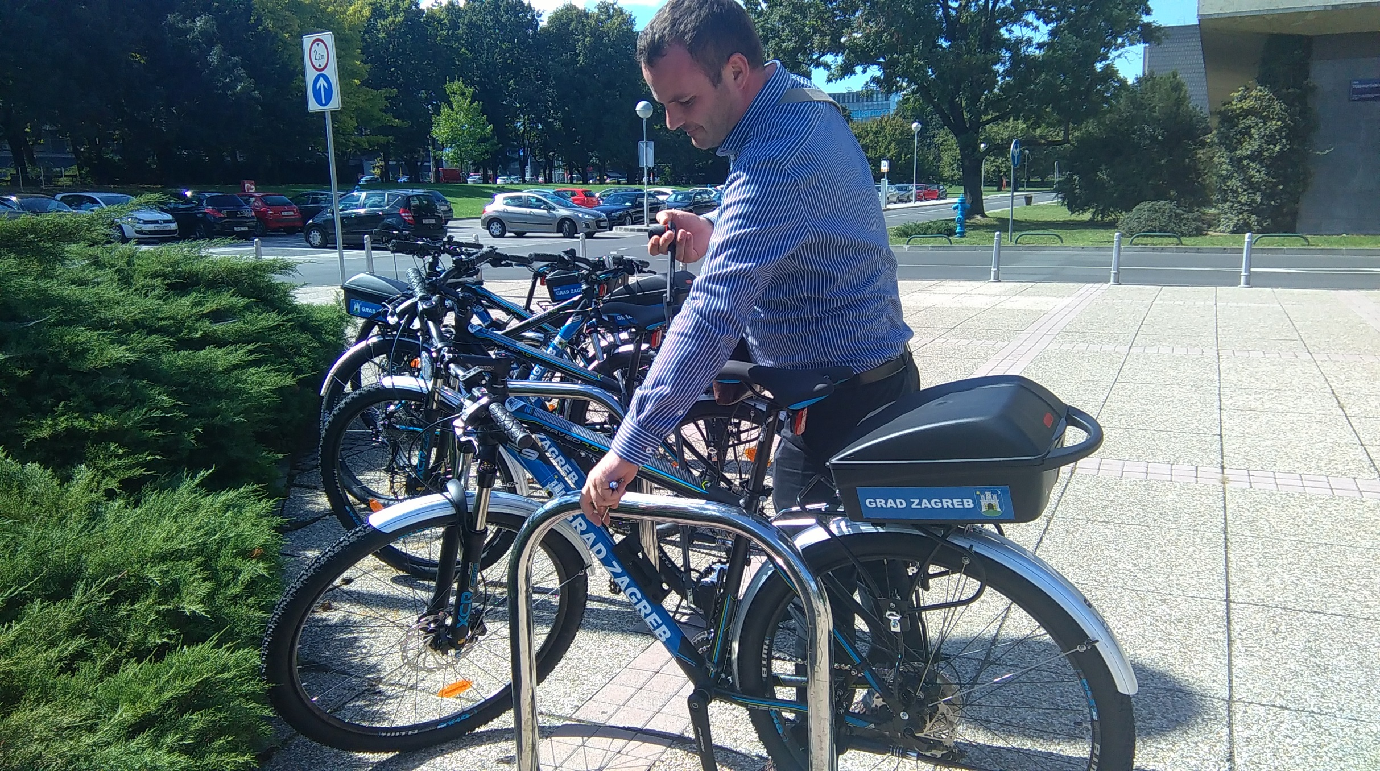
Free bike rental
Zagreb
Croatia
Smart mobility. Strong economy.
Choose. Change. Combine.
www.mobilityweek.eu
#mobilityweek

Slide 31
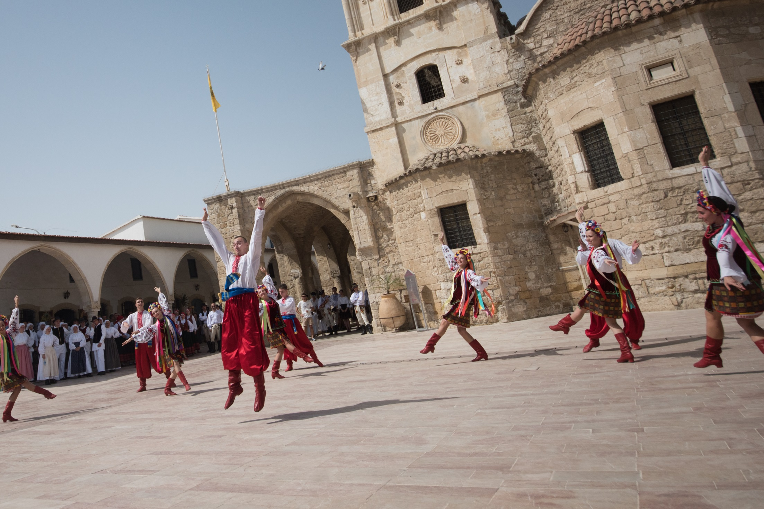
Festivals at the street
Larnaka
Cyprus
Smart mobility. Strong economy.
Choose. Change. Combine.
www.mobilityweek.eu
#mobilityweek

Slide 32
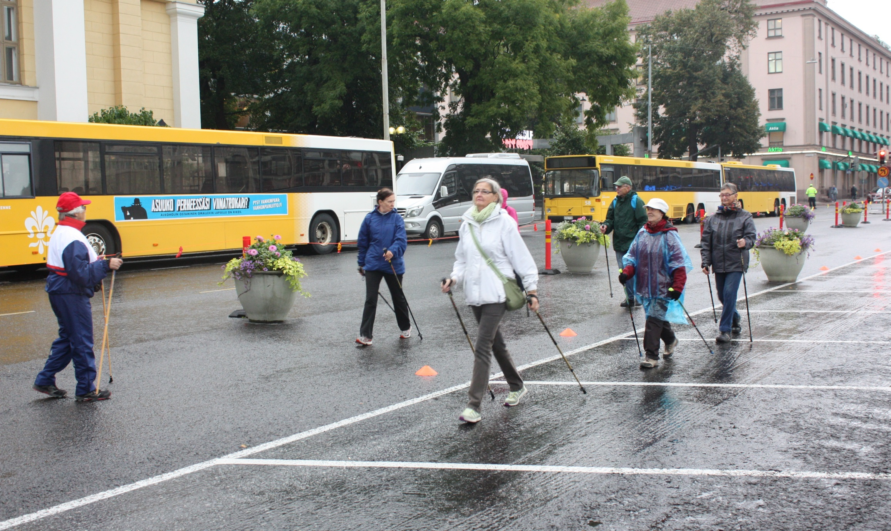
Sports
Turku
Finland
Smart mobility. Strong economy.
Choose. Change. Combine.
www.mobilityweek.eu
#mobilityweek

Slide 33
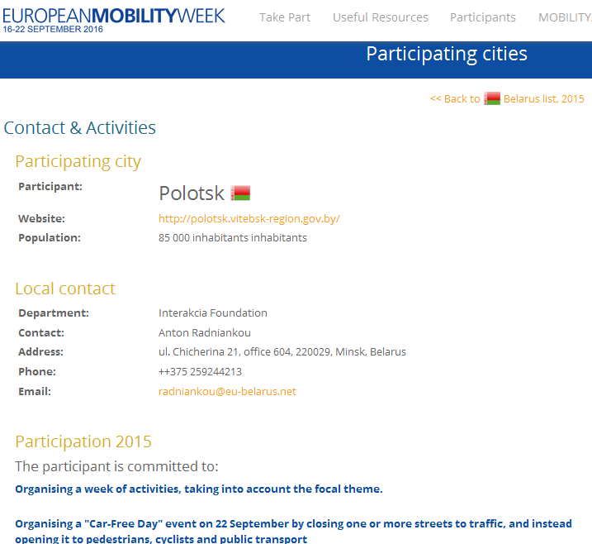
EUROPEANMOBILITYWEEK
16-22 SEPTEMBER
REGISTRATION
Even if you undertake just one of the week’s three ingredients (e.g. a single measure or car-free day), please register!
Process is simple:
  Register online (or if you did last year, login);
  Identify yourself;
  Identify your three principal activities and add details via a drop down menu
Nat. Coordinator approval
www.mobilityweek.eu/register-your-city
Smart mobility. Strong economy.
www.mobilityweek.eu
#mobilityweek #localhashtag
Notes:
Coordinators review cities registrations and approve them as participating via a Coordinators area here: http://coordinator.mobilityweek.eu/login.php before approving a city by clicking on "Edit Registration" and at the bottom of the page ticking "Approve this registration".
National Coordinator’s can also update own contact details by clicking on "Your profile" at the top right of the screen.

Slide 34
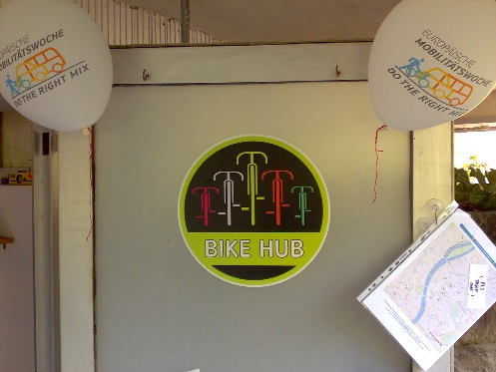

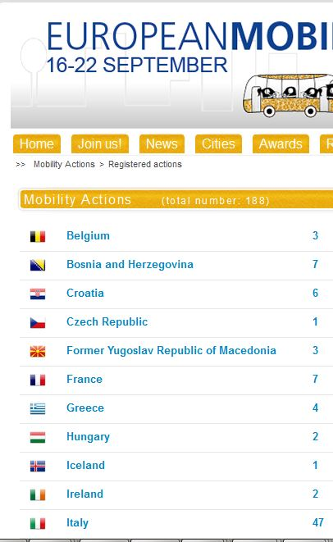
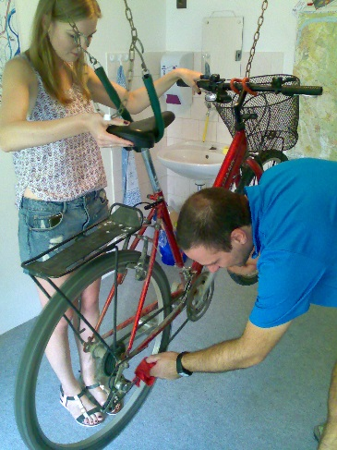
EUROPEANMOBILITYWEEK
Photo credit: Jerome Simpson
16-22 SEPTEMBER
MOBILITYACTIONS
All year round ‘add-on’ to EUROPEANMOBILITYWEEK
A platform for NGO’s, citizen groups,
employers, etc. to promote their
actions on sustainable mobility
A pool of inspiration and a basis for collaboration with local authorities
Best actions could be invited to present
at the EMW spring Workshops
mobilityweek.eu/mobility-actions
Photo credit: Jerome Simpson
Smart mobility. Strong economy.
www.mobilityweek.eu
#mobilityweek #localhashtag

Slide 35

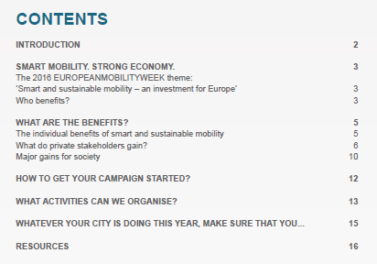

EUROPEANMOBILITYWEEK
16-22 SEPTEMBER
USEFUL RESOURCES
Annually updated
Explains the year’s slogan, from theory through to practice
Includes the policy background
Many examples illustrate how to apply the theme locally
Complemented by a resource list
Available *in brief* in 23 languages from May!
Smart mobility. Strong economy.
www.mobilityweek.eu
#mobilityweek #localhashtag
Notes:
The Guidelines at: http://www.mobilityweek.eu/fileadmin/user_upload/materials/participation_resources/2016/Thematic_Guidelines_2016.pdf provide:
national and local coordinators with background information on this theme and inspiration for suitable campaign activities.
ideas on how to implement these activities; and
campaigners the right mix of actions to match the criteria of the EUROPEANMOBILITYWEEK Award.

Slide 36
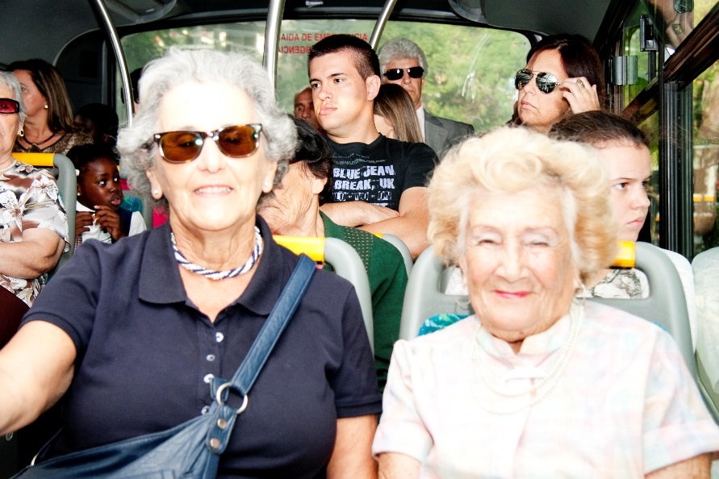

EUROPEANMOBILITYWEEK
16-22 SEPTEMBER
Smart Mobility. Strong Economy…I
Benefits for individuals:
  Financial savings (walking, cycling, using PT are cheaper than owning/using a car)
  More time to oneself
  (less time spent in traffic)
  Healthier and happier!
Photo credit: Mirjam Logonder
Smart mobility. Strong economy.
www.mobilityweek.eu
#mobilityweek #localhashtag
Notes:
This year’s theme is ‘Smart and sustainable mobility – an investment for Europe’ and corresponding slogan is ‘Smart mobility. Strong economy.’
President Junker's political priority of investment in jobs and growth. Economic advantages of choosing more sustainable travel modes, such as cycling, walking, collective or public transport, and of course cleaner vehicles. And let's not forget the excellent potential of cargo bikes for replacing conventional urban freight deliveries.

Slide 37
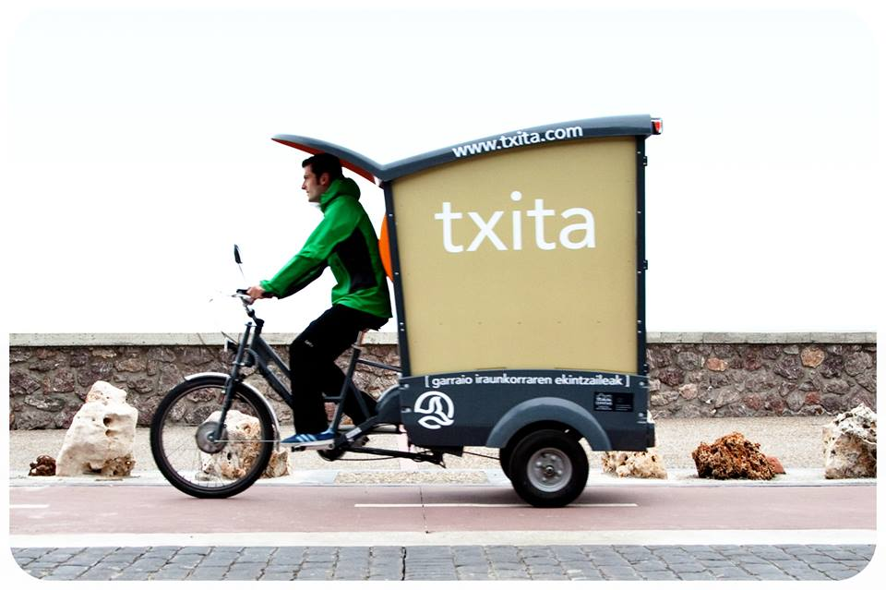
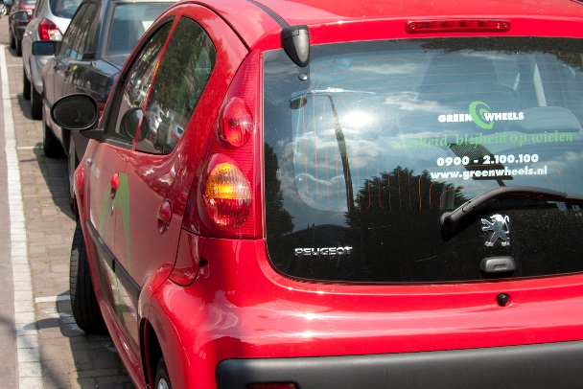
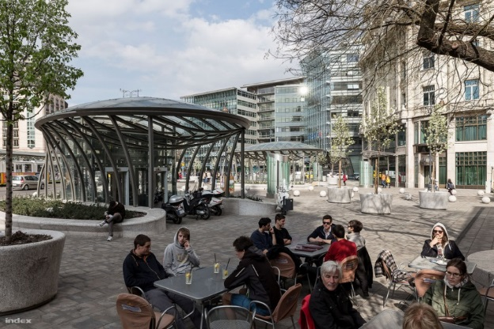
EUROPEANMOBILITYWEEK
16-22 SEPTEMBER
Smart Mobility…II
Strong Economy
Photo credit: Donostia-SanSebastian
Benefits for economic actors:
  New economic markets
  (smart shared mobility, cargo
  -bike deliveries, mobility apps,
  e-vehicles)
  Shops and restaurants:
  more frequent clients, more sales.
  More productive workers, less stress, less sick leave, happier!
Photo credit: Mirjam Logonder
Smart mobility. Strong economy.
Photo credit: Adrian Zoltan/Index.hu
www.mobilityweek.eu
#mobilityweek #localhashtag

Slide 38
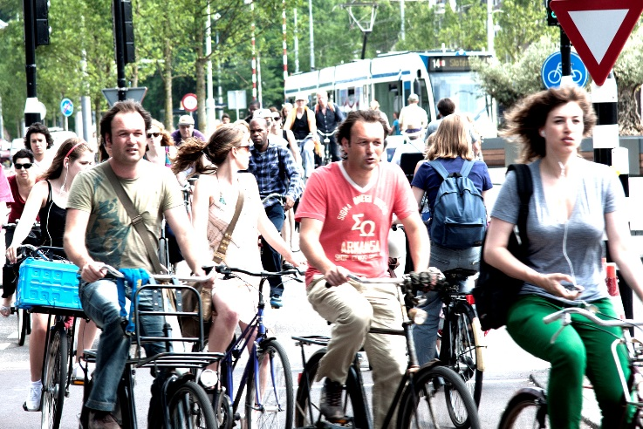
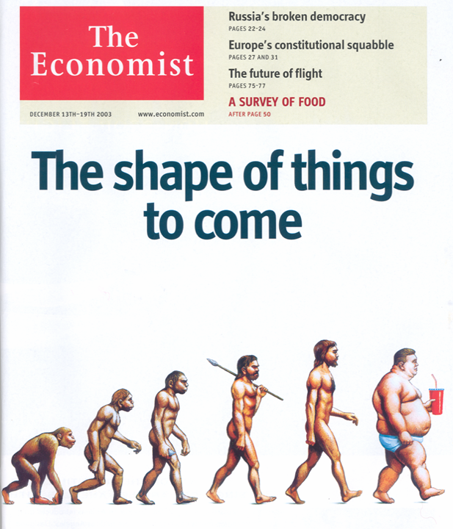
EUROPEANMOBILITYWEEK
Photo credit: Mirjam Logonder
16-22 SEPTEMBER
Smart Mobility.
Strong Economy…III
Benefits for society:
  National budgetary savings (environment, safety, health, energy, economy, etc.)
  Growth and jobs (public transport operators are major employers)
  Healthier population, cleaner air,
  less noise, living streets, etc.
Smart mobility. Strong economy.
www.mobilityweek.eu
#mobilityweek #localhashtag

Slide 39
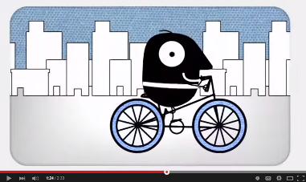
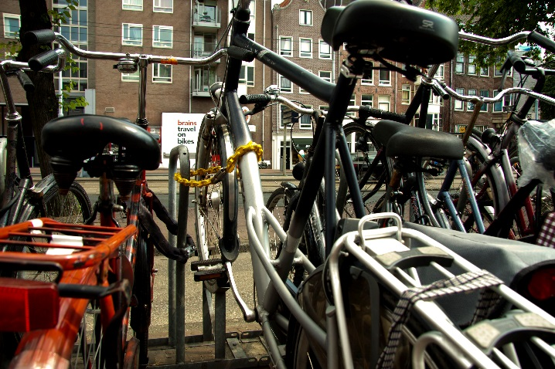
EUROPEANMOBILITYWEEK
16-22 SEPTEMBER
Smart Mobility. Strong Economy…IV
- 51% to 68% of all urban logistics can be done by bike or cargo-bike
- 49% more trade in NYC streets w bike paths
- Cyclists on average live 2 years longer and take 15% fewer sick days
- Eur 80bn saving for the EU healthcare sector
- In Belgium, replacing a car with a bike yields Eur 2853 and saves 51 hours lost in congestion per year
4.5 x € (8 vs 1)
Smart mobility. Strong economy.
www.mobilityweek.eu
#mobilityweek #localhashtag
Notes:
In Copenhagen, city authorities conclude it makes sense to invest in bicycle- rather than car-parking, saying that ‘bicycle parking potentially generates 4.5 times more revenue than car-parking space.’ This is because eight cyclists will spend more money than a single motorist using the same amount of space for parking.

Slide 40
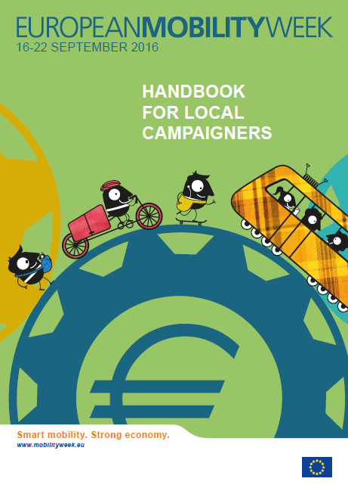
EUROPEANMOBILITYWEEK
16-22 SEPTEMBER
USEFUL RESOURCES
All you need to know to organise and promote the week!
Programme ideas for each and every day of the campaign
Examples for each of the week’s pillars
www.mobilityweek.eu/campaign-materials
Smart mobility. Strong economy.
www.mobilityweek.eu
#mobilityweek #localhashtag

Slide 41

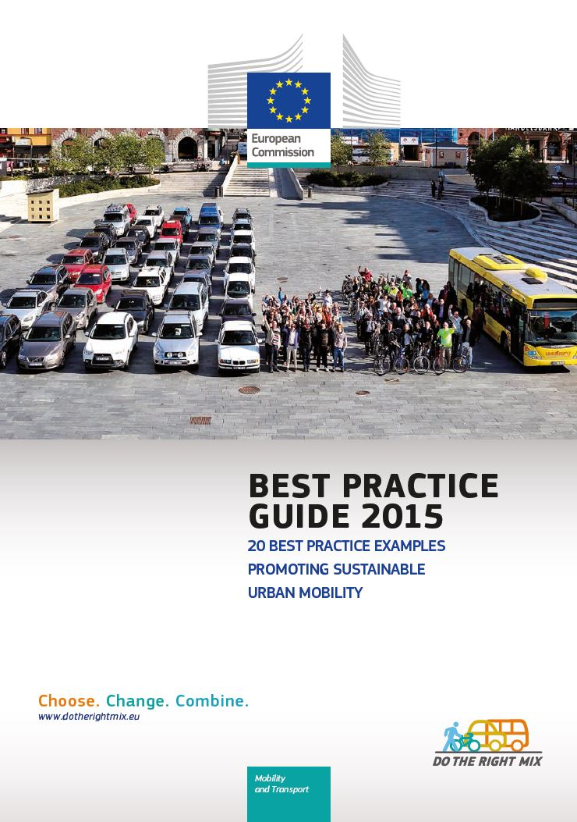

EUROPEANMOBILITYWEEK
16-22 SEPTEMBER
USEFUL RESOURCES
Best Practice Guide is updated annually
Summarises the previous year’s winner, runners up and shortlisted entries (9-10 cities’ achievements)
Each city profile accompanied by campaign tips
www.mobilityweek.eu/design-materials
Smart mobility. Strong economy.
www.mobilityweek.eu
#mobilityweek #localhashtag

Slide 42



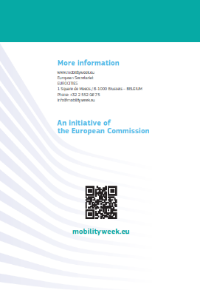
EUROPEANMOBILITYWEEK
16-22 SEPTEMBER
THANK YOU FOR
YOUR ATTENTION!
Jsimpson@rec.org • @jeromesimpson2
Smart mobility. Strong economy.
www.mobilityweek.eu
#mobilityweek #localhashtag
Notes:
If your city was involved in EMW last year, thank you for your participation!

Slide 43
EUROPEANMOBILITYWEEK
16-22 SEPTEMBER
How can this year’s theme “Smart mobility. Strong economy” be translated into EMW activities?
Chair: Jerome Simpson with Igar Tchoulba
Senior Expert, Smart Cities and Mobility, REC
27 April 2016, Minsk
#mobilityweek
Smart mobility. Strong economy.
www.mobilityweek.eu

Slide 44
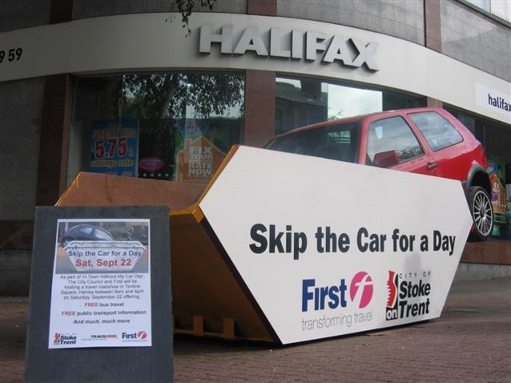
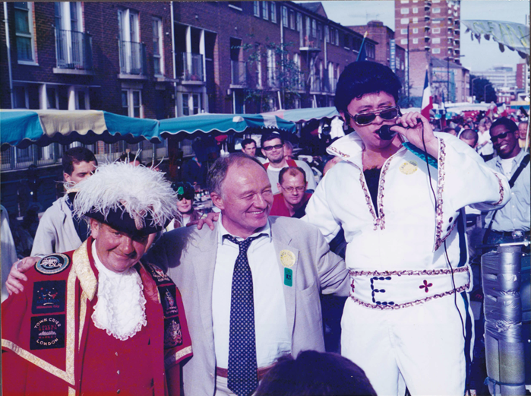
EUROPEANMOBILITYWEEK
16-22 SEPTEMBER
2016: Smart mobility. Strong economy.
GETTING YOUR CAMPAIGN STARTED…
  Choose an economic hook
  Consider more vulnerable members of society
  Define SMART objectives
  Secure political support
  Don’t be too negative (demonstrate alternatives)
  Gather evidence
  Build on existing partnerships and initiatives
Smart mobility. Strong economy.
www.mobilityweek.eu
#mobilityweek #localhashtag

Slide 45

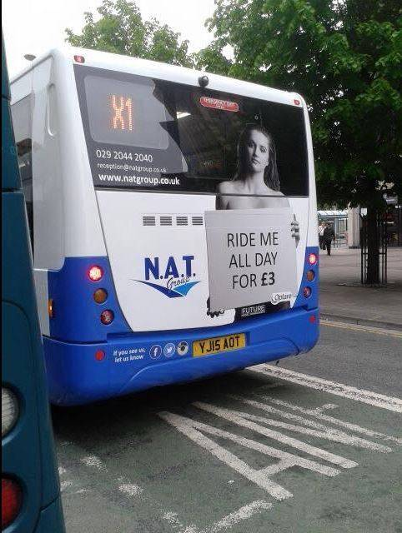
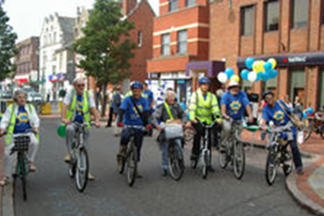
EUROPEANMOBILITYWEEK
16-22 SEPTEMBER
2016: Smart mobility. Strong economy.
ACTIVITY TIPS
  Car-free day! Promote PT!
  Promote car-cost calculators: UK & BE
  Cooperate with local shops/restaurants
  Information sessions/Infopoints
  Competitions (households,
  schools, companies, ‘hoods)
  Reward smart and
  sustainable behaviour
  Alternative use of parking
  space
Smart mobility. Strong economy.
www.mobilityweek.eu
#mobilityweek #localhashtag
Notes:
Consider cargo-bike races

Slide 46



EUROPEANMOBILITYWEEK
16-22 SEPTEMBER
2016: Smart mobility. Strong economy.
MORE ACTIVITY TIPS
How many nurses can you fit in a Mini?
Smart mobility. Strong economy.
www.mobilityweek.eu
#mobilityweek #localhashtag

Slide 47





EUROPEANMOBILITYWEEK
16-22 SEPTEMBER
2016: Smart mobility. Strong economy.
Permanent Measures
Pedestrian areas:
#1: Improvement of infrastructure
(footbridges, crossings, pavements, lighting)
Improved bicycle facilities:
#2: Improvement of bicycle
network (new lanes, extension, renovation, signs)
#4: Improvement of bicycle
facilities (parking, locks)
Photo credit: JSimpson
Smart mobility. Strong economy.
www.mobilityweek.eu
#mobilityweek #localhashtag

Slide 48





EUROPEANMOBILITYWEEK
16-22 SEPTEMBER
Permanent Measures
Mobility management:
#3 Launch of awareness
raising campaigns
Traffic calming & reduced access:
#5: Speed reduction near schools
Photo credit: JSimpson
Photo credit: JSimpson
Photo credit: MSimpsonLogonder
Photo credit: JSimpson
Photo credit: Josu Ateca Acebo
Smart mobility. Strong economy.
www.mobilityweek.eu
#mobilityweek #localhashtag

Slide 49



EUROPEANMOBILITYWEEK
16-22 SEPTEMBER
2016: Smart mobility. Strong economy.
PLEASE!
  Encourage your city to register! mobilityweek.eu/register-your-city
  Do car-free day on Sept. 22nd
  ‘Like’ the EUROPEANMOBILITYWEEK Facebook page, follow @mobilityweek on Twitter, share photos on Flickr
  Consistently apply the visual guidelines
  Promote #mobilityweek via social media and communications materials
  Consult Igar!
Smart mobility. Strong economy.
www.mobilityweek.eu
In Town
With My Car!
#mobilityweek #localhashtag

